Slide 1
SOFTWARE DESIGN AND ARCHITECTURE LAB # 01 INTRODUCTION TO RATIONAL ROSE
ENGR. SANIYA SARIM

Slide 2
Rational Rose
ROSE stands for Rational Object-oriented Software Engineering.
Rational Rose is developed by Rational Corporation which is under IBM.
Rational Rose is a tool for modeling software systems.
Rational Rose supports UML.
Rational Rose is a tool that supports round-trip engineering means a tool that supports conversion of a model to code and from code to a model.

Slide 3
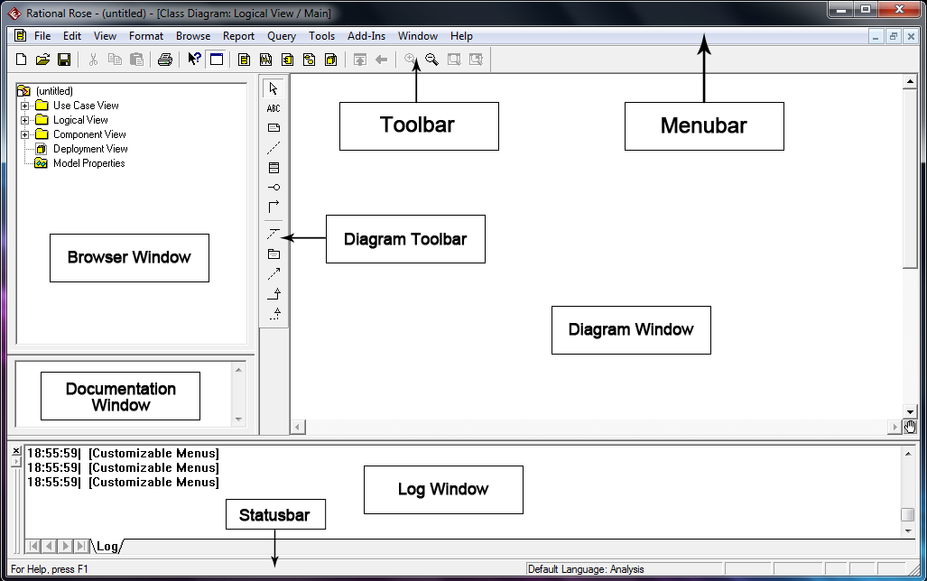
Rational Rose Interface:

Slide 4
RR Interface
Menubar: The menubar consists of several menus like the file menu, edit menu, view menu etc. All these menus contain several options.
Toolbar: The toolbar contains the most frequently used actions like New, Open, Save etc…
Statusbar: The statusbar at the bottom displays status messages.
Browser Window: The browser window displays the views: Use Case View, Logical View, Component View and Deployment View. Each of these views contains the diagrams.

Slide 5
RR INTERFACE
Diagram Toolbar: The diagram toolbar displays the symbols of the respective type of diagram.
Diagram Window: The diagram window is the place where the user draws the diagrams using the symbols from the diagram toolbar.
Log Window: This window is used to display error messages, warnings and information messages.
Documentation Window: This window is used to display the documentation related to the symbols and other aspects.

Slide 6
How to work with Rational Rose:
To start Rational Rose, type rose on the command prompt in your terminal.
2) Window for Rational Rose will open. It might take some time.
3) If you are working on a new assignment, From the File menu, select New and save it as your HW/Project name.
4) If you are continuing a previous assignment, From the File menu, select Open and select the model you want to work on.

Slide 7
Drawing the Class Diagram:
You will be working in Logical view- Processing requirements model and data storage requirements model. Shows what classes of objects are required without showing how the objects might be implemented or how the user might interact with them.
1) The Logical View Class Diagram window may already be open.If so, skip to step 3.
2) Open the Logical View Folder. Double click on the icon next to Main.(Alternately, right click on Main and select Open).
3) To draw a class, click on the class icon on the toolbar. Move the cross bar to the class diagram window and click.
4) Name the class. Note that you do not want to use the same name as an Actor in your Use Case diagram. For example, if you have a Student actor, the class should be named StudentProxy.

Slide 8
Drawing the Class Diagram:
5) Now right click on the class to add attributes and methods to your class.
6) Create all the classes you require for your class model. Using the connection symbols from the toolbar, connect the classes to show the relationship between those two classes (association, generalization/specialization or aggregation). Do the same for all the classes.
7) You can name associations using text box in the tool bar.
8) To add multiplicity information, right click on the association line and select the desired value.

Slide 9
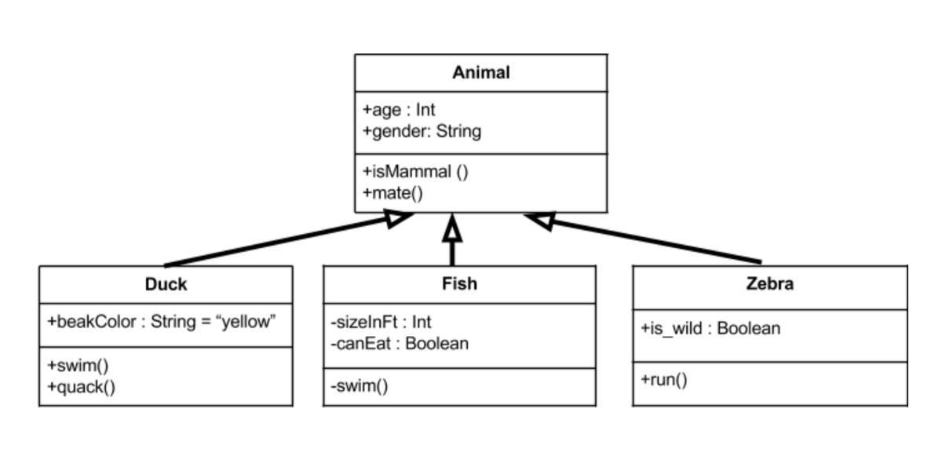
Sample Class diagram

Slide 10
Forward and Reverse Engineer
Apply forward and reverse engineering techniques on the class diagram in previous slides from steps discuss in the class.

Slide 11
Lab1 Tasks:
1: Create class diagram with 5 classes and apply forward engineering approaches to generate code
2: From forward engineering update your Generated java code and add attributes and operations in your classes.
3: Reverse Engineer your edited code in task2 and display updated UML diagram

